Slide 1
CastNXT: Event 360
Kexuan Shen & Rohith Yogi Nomula

Slide 2
Introduction
What is CastNXT:
Simplify and Automate entire event management flow
Streamlining the process of selecting/shortlisting candidates
Assigning Talent to a client and Arrange them based on preference
Producer/Admin negotiating with clients about a talent
Finalizing talent selection for an event.
Our End Users:
FashioNXT – Admins or Producers: To Manage the App.
Event Participants and Models – Talents: Search and Register for Events.
Designers and Clients: Showcase events using assigned Talents.

Slide 3
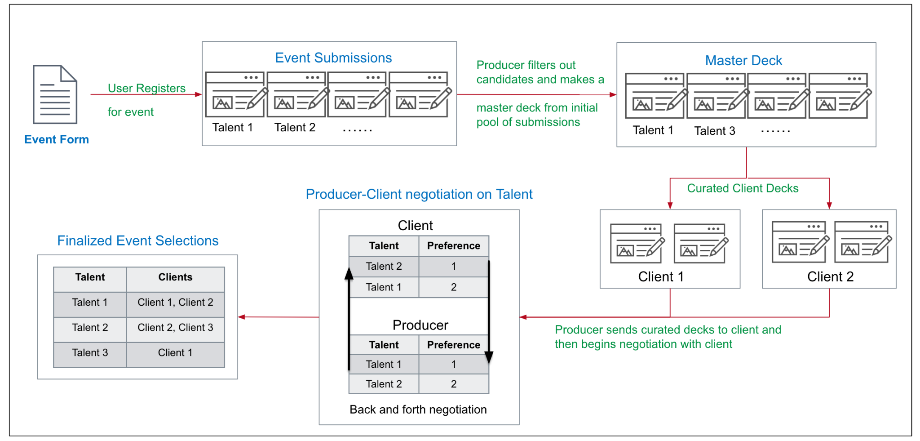
Application Flow
Tech Stack: Ruby, ReactJS(UI), Mongo(DB), JEST(testing)

Slide 4
Features
Already existing features:
Custom Form creation
Talent Event Registration
Client Decks curation
Producer-Client Negotiation
Improvements
Add new talent as a row directly to the deck without the need of sign up
Unified User : Giving the user the ability to switch between roles
Editing existing forms on a live event - reflects back to the talent
Notifications from the producer - event update/assign talent/comment
Producer-Client Messaging - Comments Section of talent deck
Payment link redirecting to payment portal (paypal/venmo)
Export table data option into csv
Modified the existing UI according to client suggestions
Validation and Bug Fixes: Debugging lot of existing issues with the functionality

Slide 5
Key Improvements
Testing Screenshots

Slide 6
Future Scope
AI enabled form creation : Integrate ChatGPT for form creation
Chat Feature : Messaging system embedded in the website
Recommendations : An algorithm that sends the talent their preferred events
Custom Color Coding : producer can color code a row based on his/her preference
Upload image from camera : Producer can take pictures from camera and insert into the form
Client Contract Feature : Cover slide to be created for Client Deck
Reset password using the link sent to our emails.
File Size issue & Image width : Uploaded image must meet certain boundaries
Check out the project board for more detailed information about the backlog https://github.com/orgs/CSCE-606-Event360/projects/11/views/7

Slide 7
The End!

